Slide 1





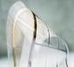

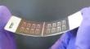




Bahgat Sammakia, Director and VP for Research
Benson Chan, Associate Director
IEEC
CHIRP
CAMM
ES2
CASP
Electronics Packaging
Heterogeneous Integration
Flexible Electronics
Energy-Smart Electronic Systems
Advanced Solar Energy
NYS CAT
SRC
DoD Mfg. USA NYS CAT
NSF Partnership for Industry
NSF I/UCRC
SB Park Director
Bahgat Sammakia; Kanad Ghose; Ganesh Subbarayan (Purdue) Co-directors
Mark Poliks Director
Kanad Ghose Director
Tara Dhakal
Director
Analytical and Diagnostics Laboratories
Jennifer Sammakia, Director

Slide 2
Advance Packaging Design and Reliability at Binghamton University A New York State Center for Advanced Technology

Slide 3
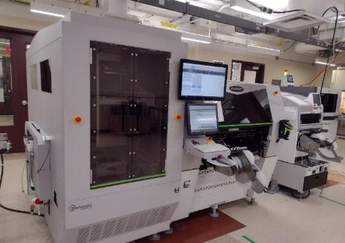
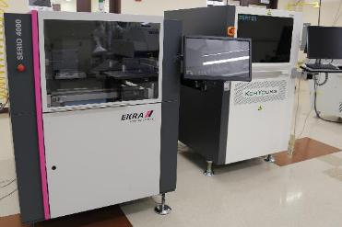
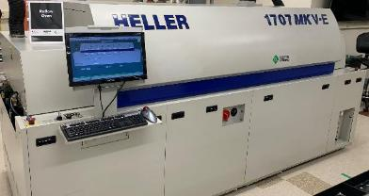
Resources / Facilities Smart Electronics Manufacturing Lab
MPM Momentum HiE Stencil Printer
EKRA Serio 4000 Stencil Printer
Koh Young Solder Paste Inspection
Universal Fuzion Pick and Place (CAMM)
Universal High Speed Wafer Feeder (CAMM)
Fine Tech Pico Ma (manual bonding/component placement (CAMM)
Heller 1707W Reflow Oven
Koh Young Automated Optical Inspection
Fuji Placement tool
PVA Conformal Coating / Underfill
Koh Young Automated Optical Inspection
Koh Young Meister – conformal coat and underfill inspection

Slide 4
Resources / Facilities Smart Electronics Manufacturing Lab
MPM Momentum HiE Stencil Printer
EKRA Serio 4000 Stencil Printer
Koh Young Solder Paste Inspection
Universal Fuzion Pick and Place
Universal High Speed Wafer Feeder
Heller 1707W Reflow Oven
Koh Young Automated Optical Inspection
Fuji Placement tool
PVA Conformal Coating / Underfill
Koh Young Automated Optical Inspection
Koh Young Meister – conformal coat and underfill inspection

Slide 5
Advance Packaging – IEEC
Provides expertise in:
Environmental and Reliability testing, test vehicle design, build and data analysis
Teardown analysis, construction analysis, understand latest trends in packaging
Failure analysis, root cause, analytical and diagnostic tools
Mechanical and thermal modeling, warpage understanding and control, large body sizes
Materials characterization, interactions

Slide 6
Warpage Control for Advance Packaging

Slide 7
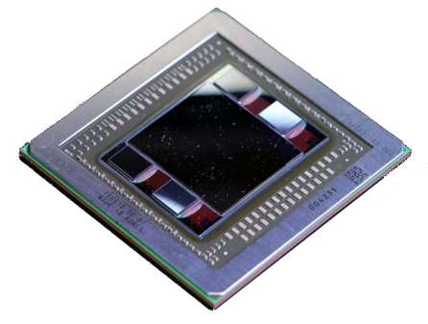
2.5D Package Development
AMD Fiji Package
Large Graphics Processor
(4x) High Bandwidth Memory (HBM, 4 die stack)
Mechanical Modeling
Thermal Modeling
Model verification using Digital Image Correlation (DIC)
Materials evaluation
Assembly process development, assembly order

Slide 8
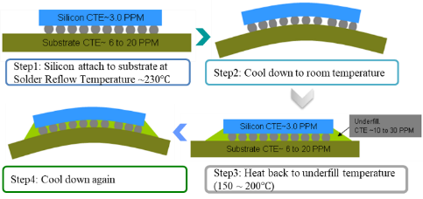
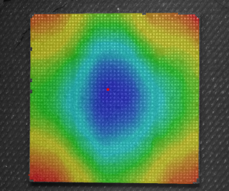
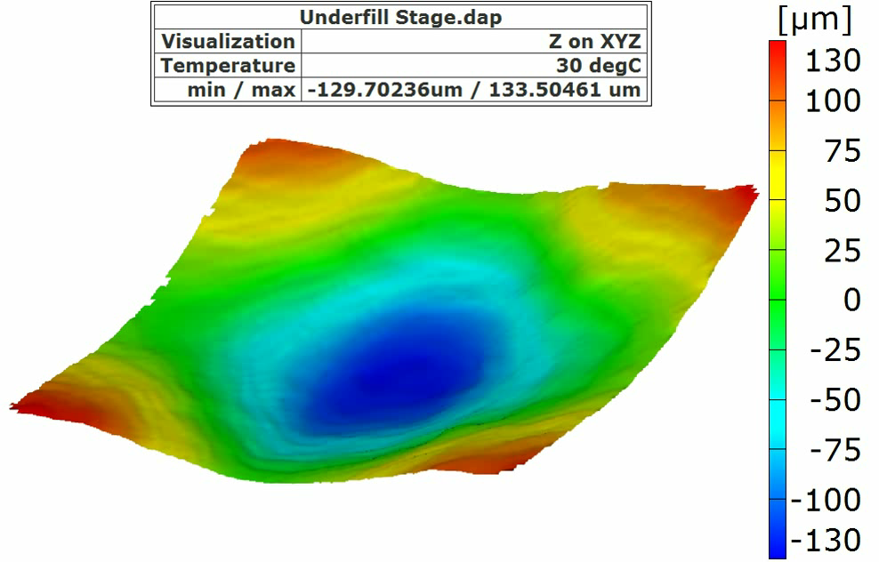
2.5D Warpage Studies
In most packaging architectures, manufacturing steps occur at elevated temperatures when the assembly is nearly plat. As cooling takes place, out-of plane deformation can occur due to CTE mismatches.
Non-uniform expansion/contraction of die and substrate in temperature cycle.
Results in warpage of the package which is major reliability concern.

Slide 9
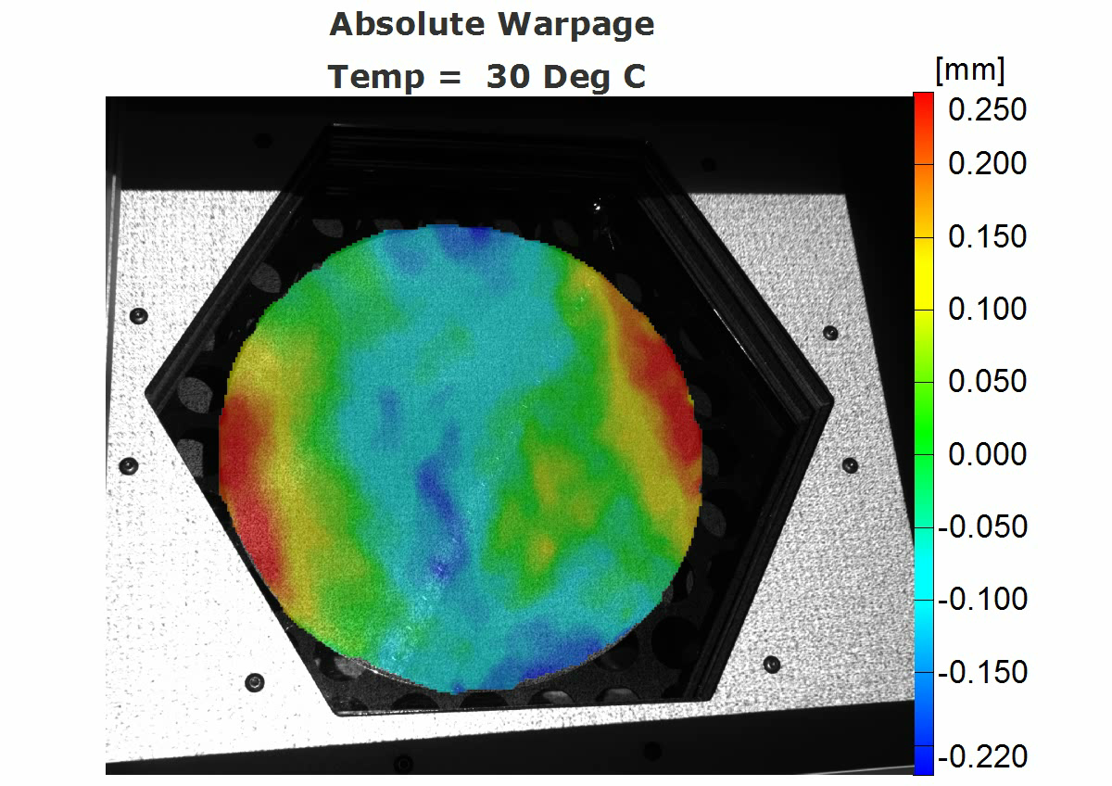
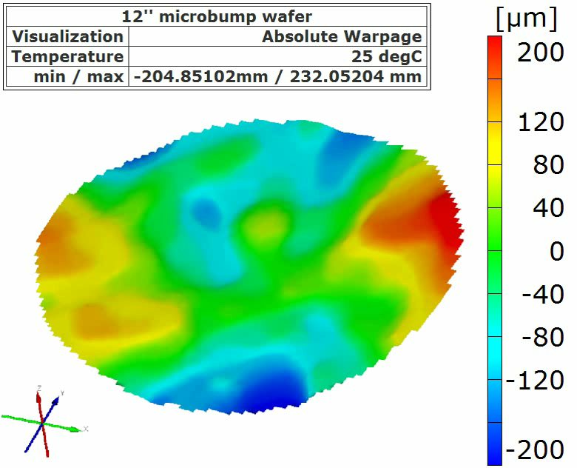
Wafer Warpage During Reflow
300 mm fully defined and back ground wafer processed in a reflow cycle from 25 °C to 240 °C
Digital Image Correlation (DIC) warpage measurement was measured through the simulated reflow temperature cycling

Slide 10
Failure Isolation and Analysis of a Functional Circuit Board

Slide 11
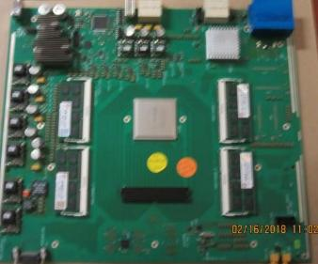
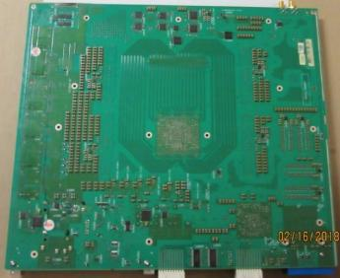
Background
A populated printed circuit board was returned to a client
This was an impedance test fail on a populated board
Labeled as an “open” trace
NOTE: “open” means out of spec high, in this case “open” was an Ohm or two
Two objectives to be met
Isolate the failure
Determine the cause of the failure
To facilitate failure isolation, the client provide circuit design for the affected area
General area of the defect(s)

Slide 12
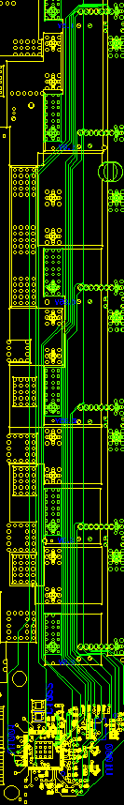
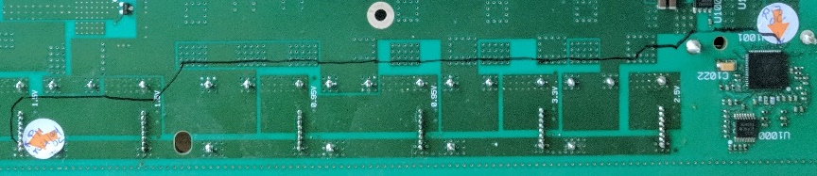
Routing of the Trace in Question
Pen marking shows the routing of the circuit line, which was all on one internal layer

Slide 13
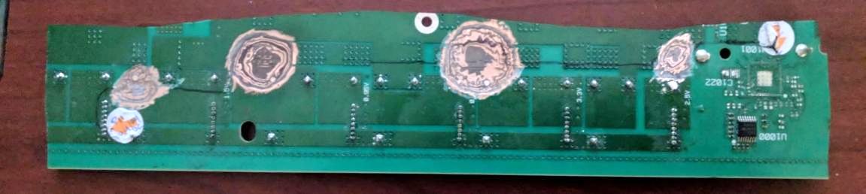
Exposing Probe Points in the Board
Pits were dug down to, and beyond the plane of the affected circuit line – traces were exposed to allow probing
1st was in the center (1)
High resistance remained between the center and the left and right ends
2nd set (2 and 3) was dug between the center and ends
High resistance remained between 2 and the left end, and between 3 and the right end
Continuity was observed between 1 and 2 and between 1 and 3
Last pit (4) was dug between the left end and location 2
Continuity was observed between 2 and 4
High resistance was found between 4 and the left end
4
2
3
1

Slide 14
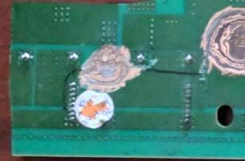
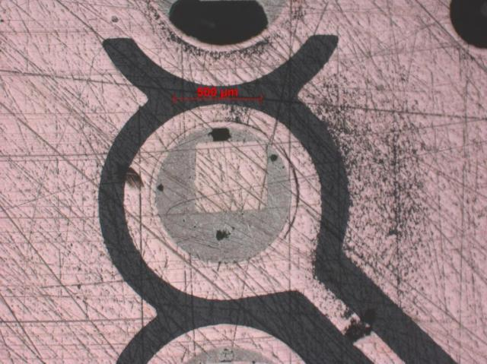
Final Analysis of the Failure
Flat sectioned
Final isolation
The left section was excised from the board
Flat sectioned to the layer in question
The flat section expose additional areas that could be used as probe points (a, b, and c)
Probe results
Continuity between a and b
High resistance between b and c
a
c
b

Slide 15

Conclusion
Fine dark line around the edge of the pad
This is drill smear
The plated via does not fully contact the pad
This accounts for the high resistance reading
Some contact affords continuity but not to a low enough resistance
Other pads in the flat section showed drill smear
In this case, pass/fail is a matter of degree
Other pads had sufficient contact with the via to allow acceptable trace continuity

Slide 16
Joining Metallurgy Characterization between M1 chip and Si Bridge in Apple M1 Ultra Package

Slide 17
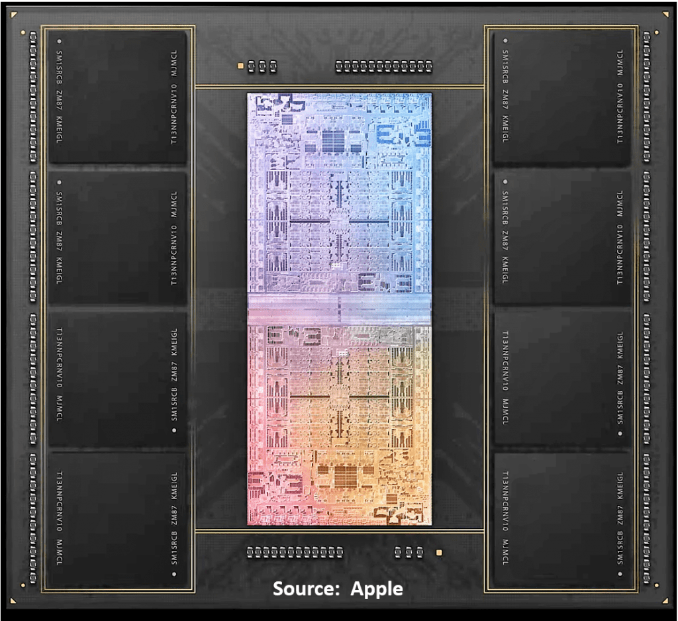
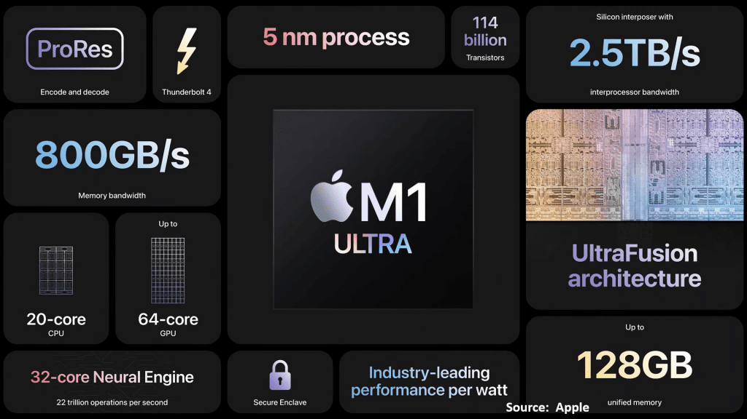
Apple Mac Studio Ultra
Silicon bridge connection
70mm Package

Slide 18
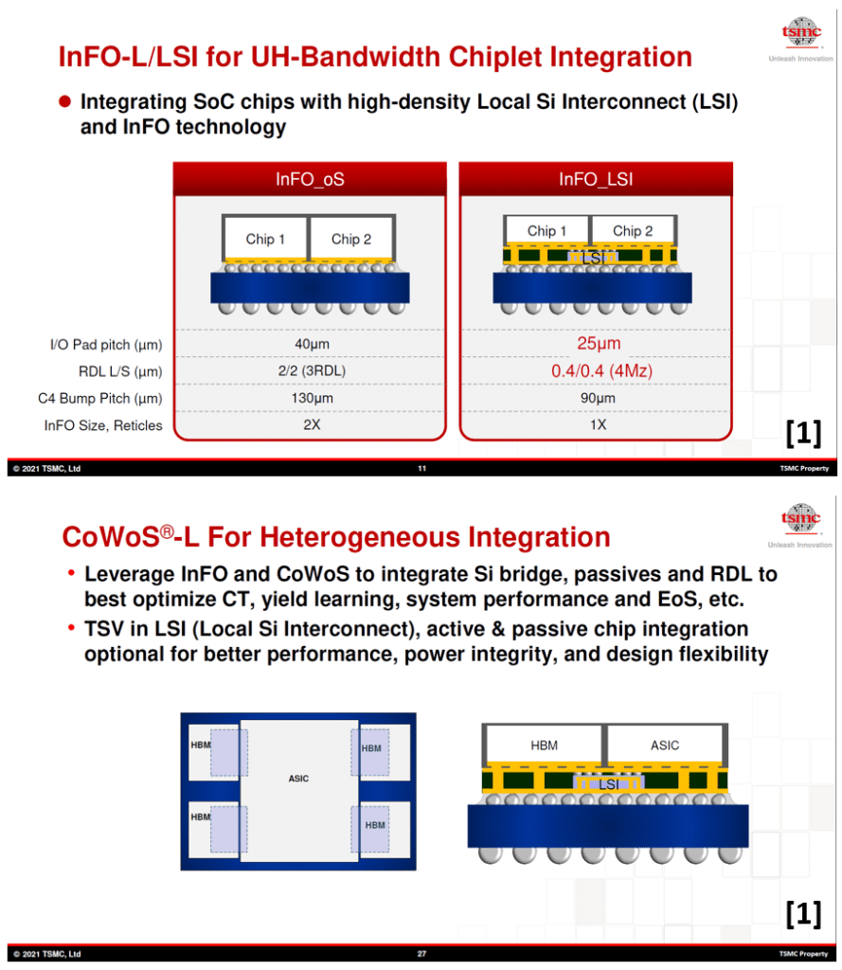
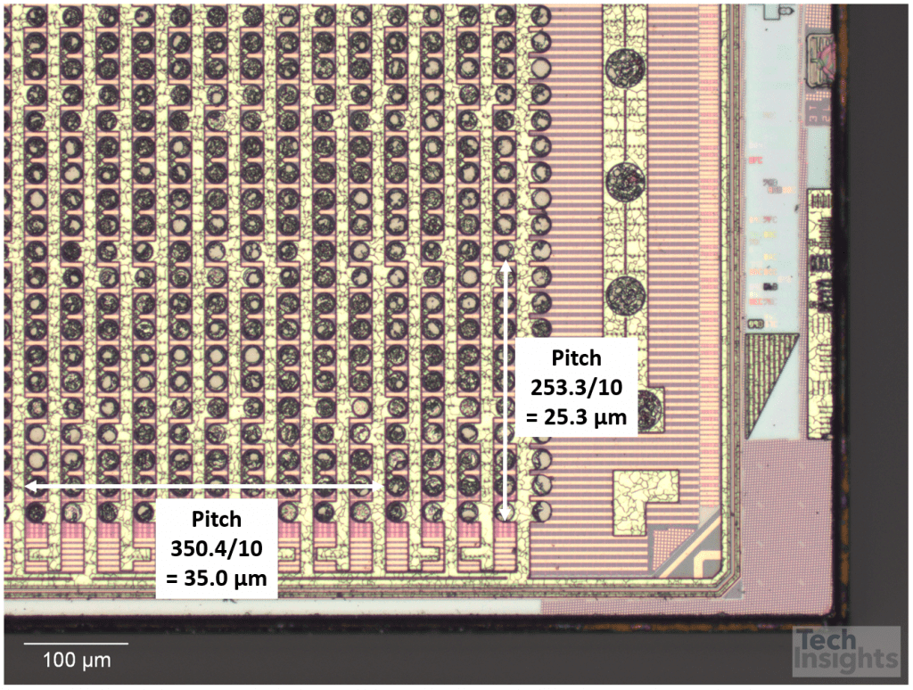

Slide 19
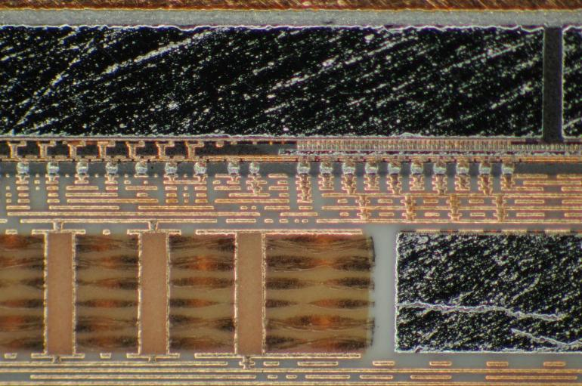
Joining metallurgy between Apple Ultra M1 logic chip and Si bridge
M1 chip circuits
Si bridge circuits
Core Substrate w/ embedded device

Slide 20
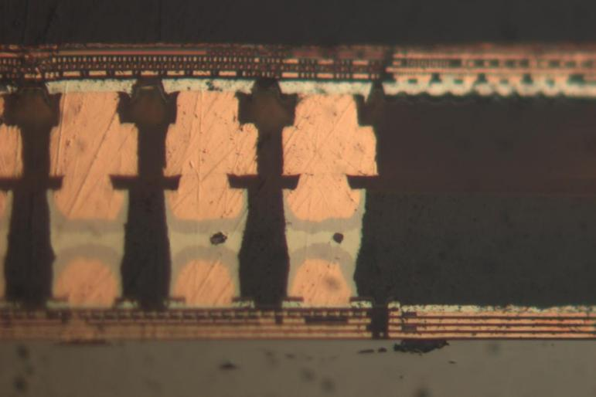
Joining metallurgy between Apple Ultra M1 logic chip and Si bridge
M1 chip circuits
The second cu bump is made to enhance the strength of the interconnect, compare to solder on flat, the solder is able to have more surface area. The top bump is also 10% larger than the bottom to better distribute stress
Polyimide
Cu bump
Sn
Underfill 1
Cu bump
Aluminum final metallization
Si bridge circuits
25 micron pitch

Slide 21
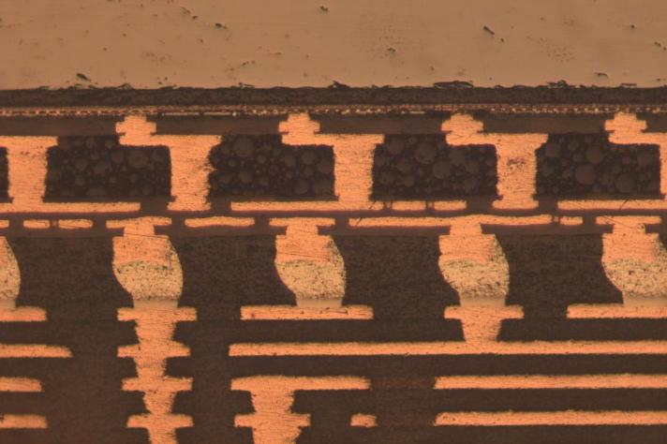
Joining metallurgy between Apple Ultra M1 logic chip and Si bridge
Aluminum final metallization
M1 chip circuits
Cu bump
Through Mold Via
RDL
C4 Bumps
Underfill 2
Si bridge circuits

Slide 22
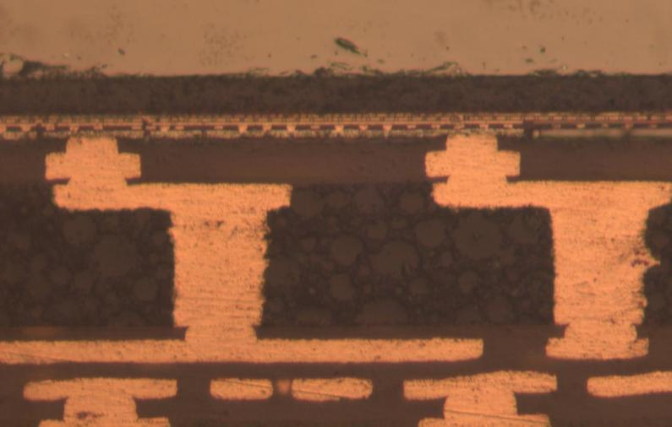
Joining metallurgy between Apple Ultra M1 logic chip and Si bridge
Aluminum final metallization
M1 chip circuits
Cu bump
Polyimide
Thru mold vias (outside of bridge region)
EMC 1
Cu bump
RDL

Slide 23
Overall cross section showing Si bridge, substrate, BGA, and PCB
Micro bump joining for M1 and Si bridge
C4 (flip chip joining)
Substrate cross section
BGA
PCB board cross section

Slide 24
Overall cross section showing Si bridge and substrate at higher magnification
Cu Bump M1 chip
Underfill 1
Molding compound
Micro joining metallurgy
Si bridge
Underfill 2
Backside grinding plane
C4 bump
3 layer RDL
Solder mask
8-2-8 Substrate

Slide 25
A cross section of Si Bridge and substrate Interface edge
Underfill Fillet
PSPI and wiring
Micro bump joining for M1 and Si bridge
C4 (flip chip joining, not shown here)
Underfill 1 (for micro joining)
Si bridge diced edge
Backside grinding plane
PSPI and wiring levels formed after backside grinding
Molding compound
Substrate
Underfill 2
Solder masks

Slide 26
Micro bump pitch of Si bridge joining metallurgy
Measurements showing about 25 micron bump pitch for both M1 and Si bridge.

Slide 27
M1 Ultra packaging “thought” assembly process (tentative)
Si bridge wafer finishing and bump formation
M1 chip wafer finishing and bump formation
Singulation mechanical dicing and reconstitute to a wafer (2 M1 dies very accurately)
Dicing for singulation
D2D attach by micro bump joining
Underfill 1 for micro bump joining
Thinning Si bridge sides of molded wafers
Build up Cu wire/PSPI layer
8-2-8 substrate
PCB main board
C4 solder bumping
M1 backside thinning
Chip joining by reflow
Assembly refow
Dicing for singulation
Underfill 2 for C4
M1+M1+ Si bridge subassembly
BGA attach

Slide 28
Copper Hybrid Bonding – AMD Ryzen 7 5800X3D

Slide 29
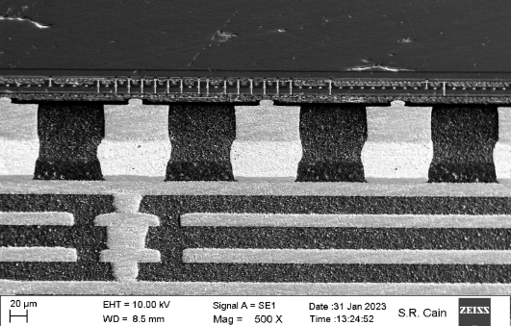
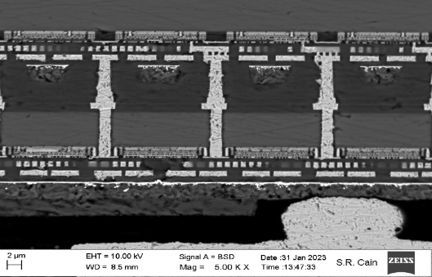
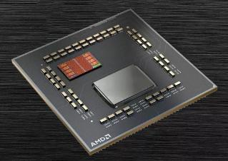
Die Stacking in AMD Ryzen 7 5800X3D
1.6 um dia
16 um
Source: Binghamton University & Prismark Partners
Stacked L3 cache
Direct Copper to Copper Bond: ~1.6 um dia columns on 15.5 um pitch
Source: AMD

Slide 30
Apple iPhone 16Pro Camera module, CuCu Hybrid Bonding

Slide 31
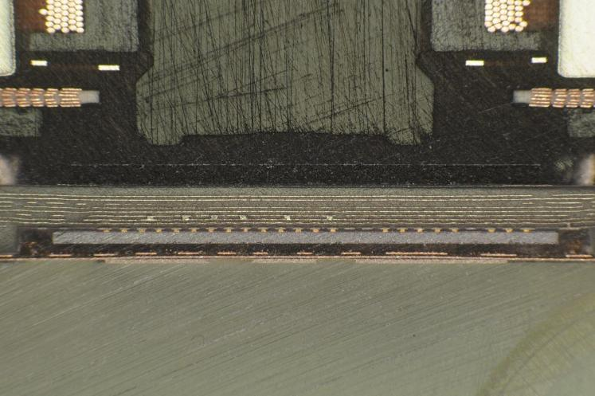
Camera Module 2 Cross Sections
IR Filter
Sensor
Interconnect
Camera Image Sensor

Slide 32
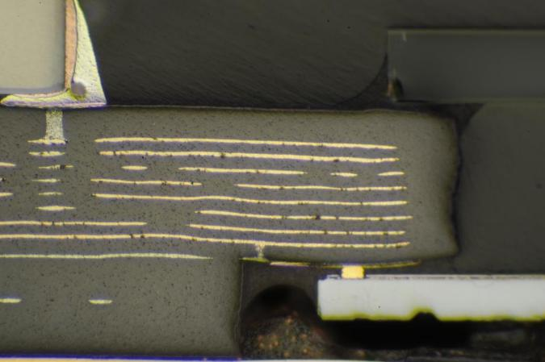
Camera Module 2 Cross Sections
IR Filter
Sensor
Interconnect
Camera Image Sensor

Slide 33
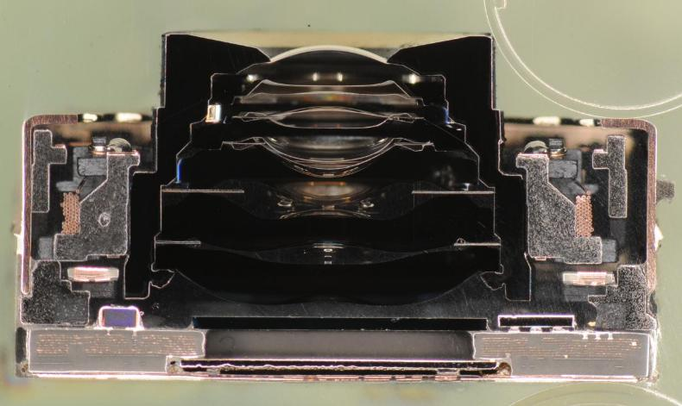
Camera Module 2 Cross Sections
Lens Stack
IR Filter
Camera Sensor

Slide 34
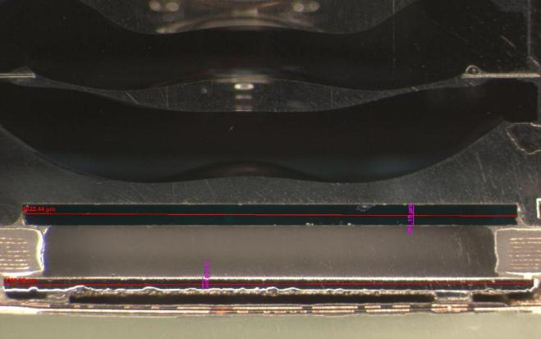
Camera Module 2 Cross Sections
Lens Stack
IR Filter
Camera Sensor

Slide 35
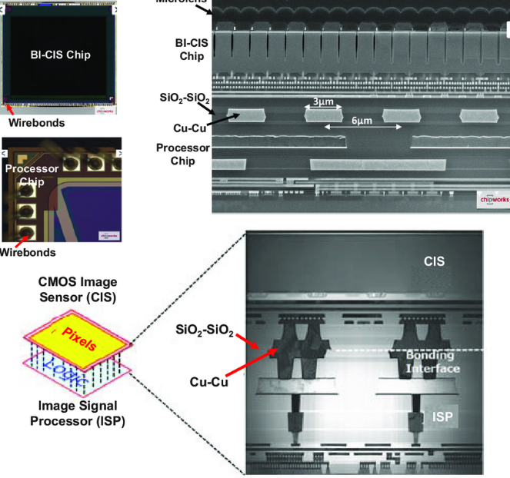
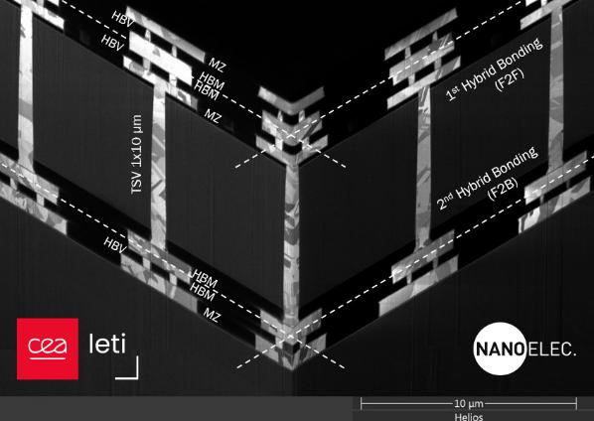
Camera Module 2 Cross Sections

Slide 36
Camera Module 2 Cross Sections

Slide 37
Camera Module 2 Cross Sections

